Slide 1
CYBR 520
Group 1
Final Project
Enhancing IoT Security Through Machine Learning Anomaly Detection
Birke Jennings
Bryant Spencer
Thaddeus Wright

Slide 2
IoT in Daily Life
01
Common IoT Devices
Smart Thermostat
Smart Appliances
Smart Cameras
02
Security Risks
Unauthorized Access
Data Breaches
03
Project Goal
Improve IoT Security through the use of Machine Learning

Slide 3
Objectives
Network Traffic Analysis
Examining network patterns from devices like smart fridges, thermostats, etc.
Security Through Machine Learning
Anomaly Detection
Train Machine Learning model to detect unusual activities, such as unexpected data spikes.
Proactive Solutions
Proposing strategies such as secure device setup and regular network monitoring
Social netorks

Slide 4
IoT Growth
Market Trends
IoT market growth projection to USD 338.28 billion by 2030 (Fortune Business).
Role of Consumer Electronics
Integration into household items.
Tech Integration
Future of AI enhancing smart home functionalities.

Slide 5
Methodology
Data Source
CIC IoT Dataset 2022 .csv file for diverse network traffic data.
Analytical Techniques
Applying Isolation Forest algorithm for anomaly detection.
Results
Examining the results of the trained Isolation Forest algorithm.

Slide 6
Data Cleaning and Preparation
Memory Optimization
“Low_Memory” option for large data types to help with overflow issues.
Added function to optimize the DataFrame memory by downcasting numeric columns to smaller data types
Handling Inconsistencies
Addressing missing values and mixed data types.
Duplication Removal
Removing repeated records from IoT device logs

Slide 7
Justification of Isolation Forest Model
01 | Unsupervised Learning
 | Works effectively with unlabeled network data, ideal for diverse IoT datasets.
02 | Scalability
 | Capable of handling large-scale sets of IoT data.
03 | Low False Positives
 | Reduces incorrect anomaly detection enhancing accuracy.
04 | High-Dimensional Data
 | Manages complex datasets without extensive level of preprocessing.
05 | Efficient Anomaly Detection
 | Quickly identifies outliers, crucial for spotting unusual network traffic.

Slide 8
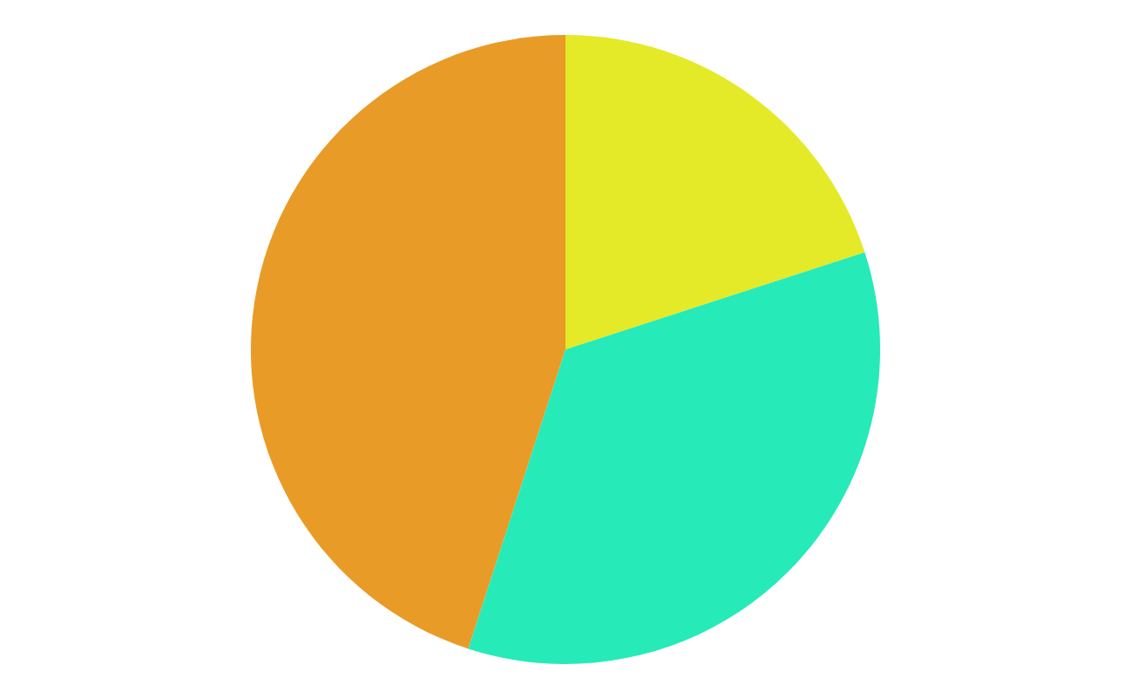
Results and Analysis
Key Findings
The algorithm was successful in identifying anomalies within the data set.
Anomaly Analysis
The added script produced the number of detected anomalies along with % of data being anomalies.

Slide 9
Discussion and Conclusion
Interpretation of Results
1
Our research is not only feasible but also applicable to improving IoT cybersecurity.
Study Limitations
2
Limited python knowledge for export labeling in callback feature.
Future Study Direction
3
This study could be extended to improve user ability for having non-technical employees be able to use it as well as improve the output features of the script.

Slide 10
Cybersecurity Solutions and Best Practices
01
02
03
Proposed Solutions
Best Practices
Practical Application
Implementing stronger authentication methods for device access
Regular firmware updates and network traffic monitoring for IoT devices
Use study to emphasize potential need for enhanced security protocol for smart home cameras/security devices.

Slide 11
(Fortune Business) Smart home market size, share &amp; trends: Statistics [2030]. Smart Home Market Size, Share & Trends | Statistics [2030]. (2023, July). https://www.fortunebusinessinsights.com/industry-reports/smart-home-market-101900
Sources
Thank you for watching!

